Slide 1

Statistical Enrichment Analysis of Sample Clinical Attributes Using SEAS
Jake Y. Chen, PhD, FACMI, FAIMBE
Professor & Chief Bioinformatics Officer
The University of Alabama at Birmingham, USA
jakechen@uab.edu | bio.informatics.uab.edu
July 29th 2022

Slide 2
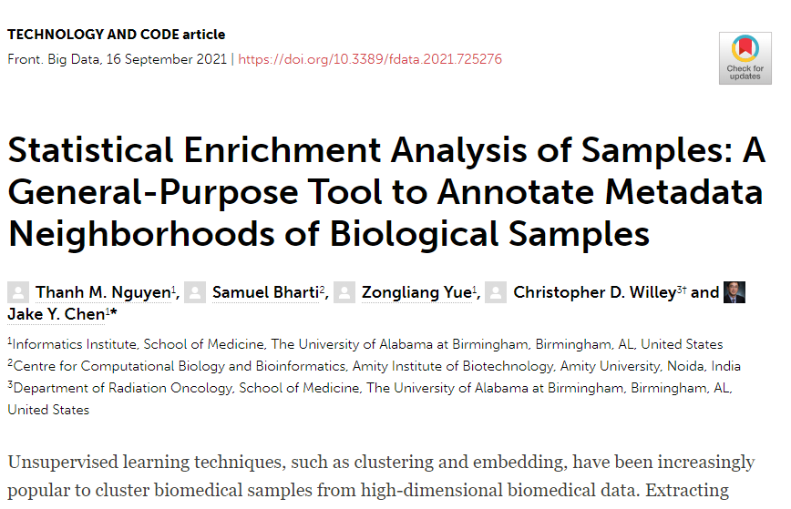

Slide 3
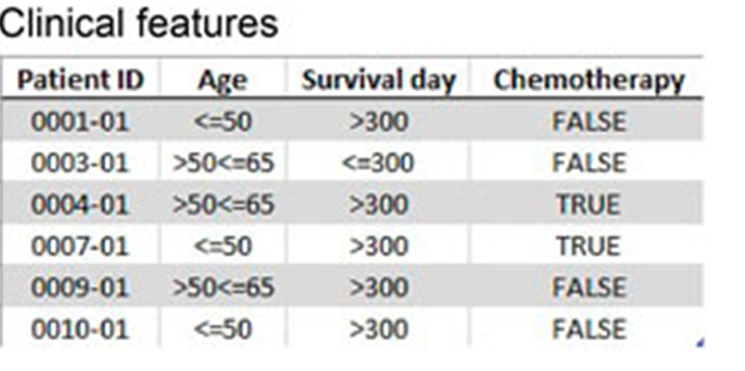
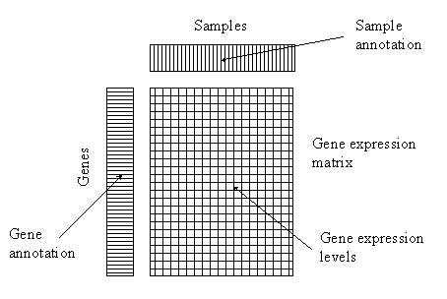
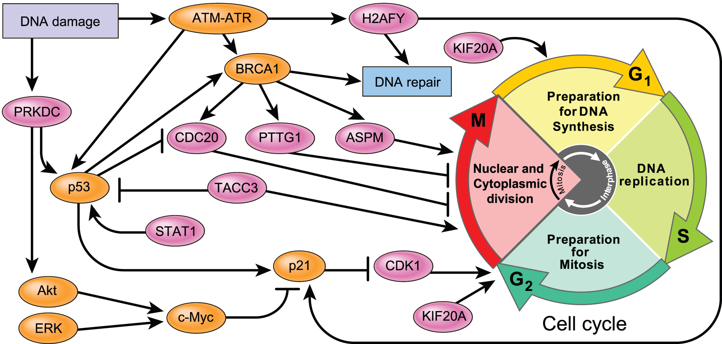
Background: Exploratory Analysis of Samples
Gene Expression Profiling of multiple patient samples
Adapted from: Mark Reimers (2008) An Opinionated Guide to Microarray Data Analysis

Slide 4
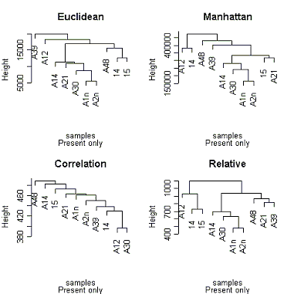
Background: High-dimensional data Clustering can be unstable and algorithm-dependent
Adapted from: Mark Reimers (2008) An Opinionated Guide to Microarray Data Analysis

Slide 5
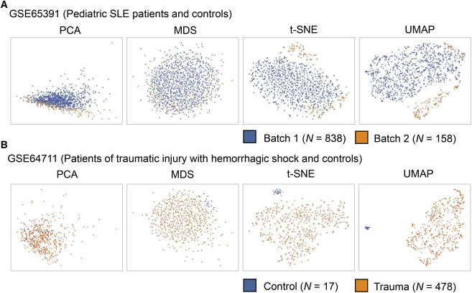
Dimensionality reduction techniques: Embeddings To detect sample-to-sample heterogeneity in “bulk analysis” of patient samples
Linear embeddings do not separate samples well
Non-linear embeddings can separate samples better
In Cell Reports, Vol. 36, No. 4, 27 July 2021, 109442

Slide 6
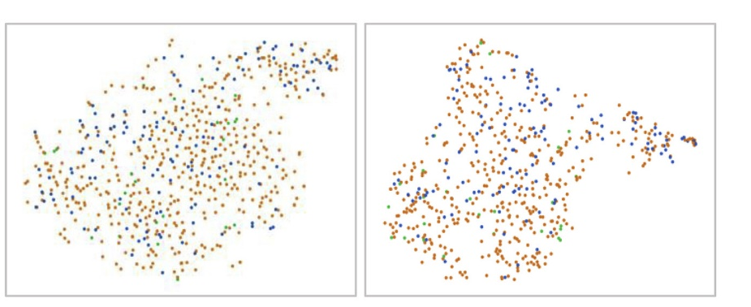



Exploration Case Study: by smoker status vs. by gender Yielding different functional genomic profile insights
tSNE
UMAP
GSE71220 (COPD Patients with Different Smoking History)
by smoker status
tSNE
UMAP
by gender
In Cell Reports, Vol. 36, No. 4, 27 July 2021, 109442

Slide 7

Motivation for developing SEAS
.
Statistical Enrichment Analysis of Samples (SEAS) is developed to perform exploratory analysis of embedded sample data from omics studies.
The method derives its power by focusing on the “clinotypes” of selected sample sets in an embedding neighborhood, i.e., groups of biological samples that may share specific clinical characteristics different from that of the background.
Examples of “clinotypes” are: age group, gender, treatment status, or survival days.

Slide 8
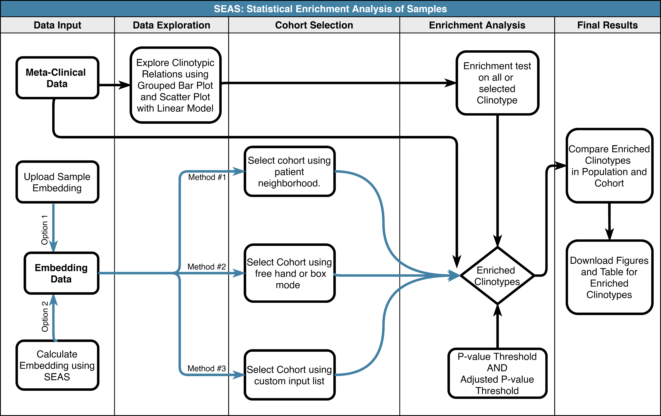
SEAS Exploratory Data Analysis Workflow

Slide 9
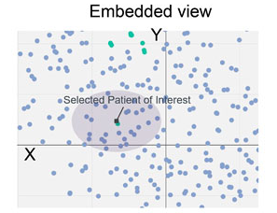
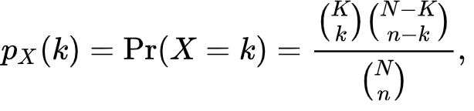
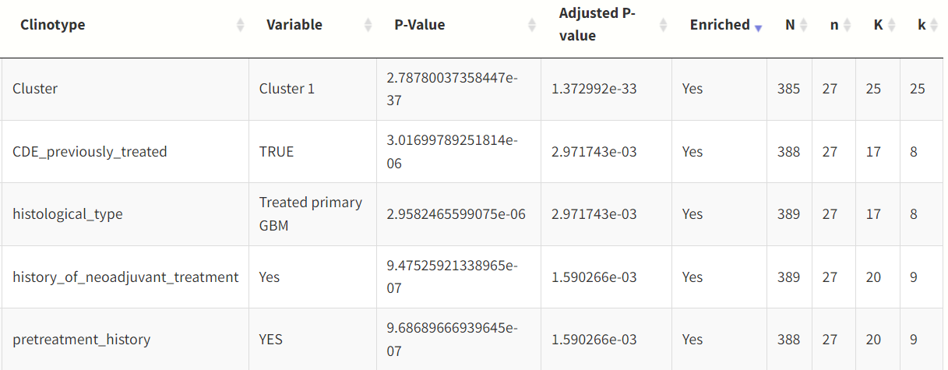
How does SEAS work?
SEAS currently handles discrete clinotypes and their enrichment in the query sample set. (In future implementation, we will handle continuous clinotypes and their enrichment. The enrichment test is therefore a simple hypergeometric test overall all available clinotypes for each sample.
N: # of samples in the population
n: # of samples in the selected patient sample embedding neighborhood
K: # of samples with a specific clinotype in the population
k: # of samples in the selected patient sample embedding neighborhood

Slide 10
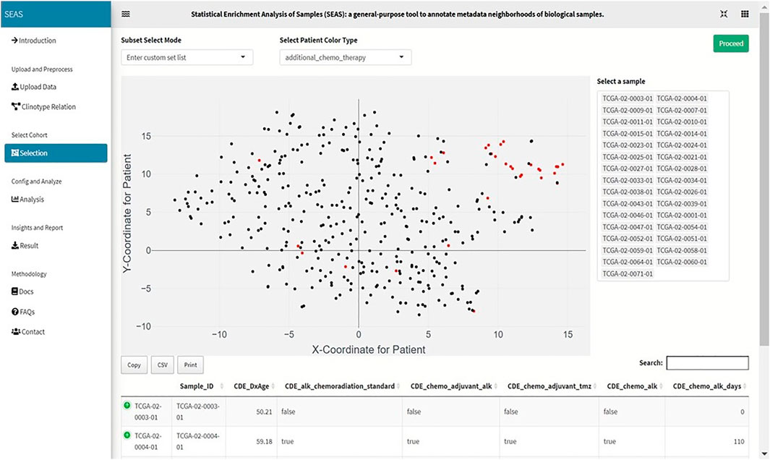
SEAS also allows sample set composition based on shared labels instead of shared embedding neighborhood

Slide 11
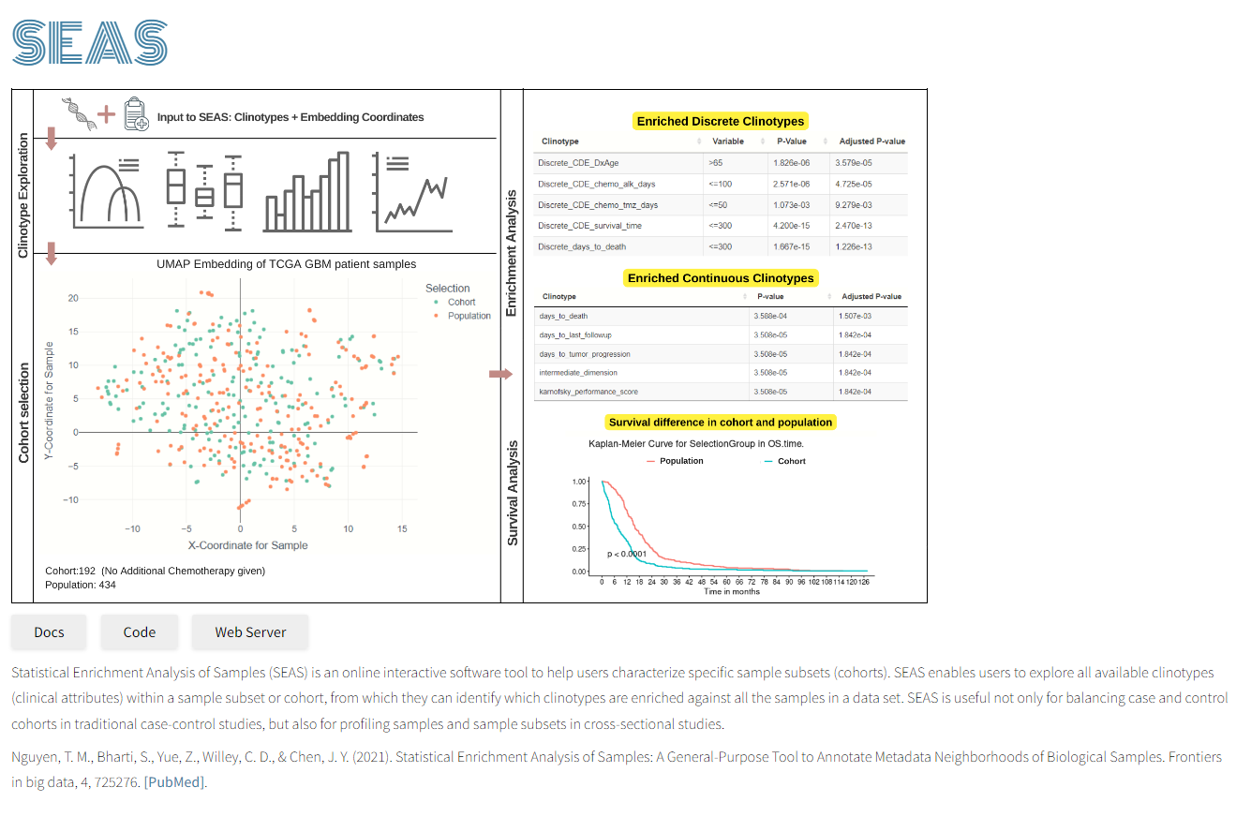
https://aimed-lab.shinyapps.io/SEAS/
https://aimed-lab.github.io/SEAS/

Slide 12





Acknowledgment
The AI.med Lab
O’Neal CCC
Ehsan Saghapour, PhD
Zongliang Yue, PhD
Thanh Nguyen, PhD
Zhandos Sembay, MS
Samuel Bharti
Chris Willey, MD, PhD
T. Stackhouse, PhD
U54TR002731
U01CA223976
R01AI134023
R01AR073850

